Slide 1

FudgeMart Inc. Data Warehouse & Business Intelligence Solution
Ist722 - Group2 : Keeley Ables, Steve Lamarre,
Subbu Kandhaswamy, Zachary agrue.

Slide 2


Business Overview
FudgeMart is an online retail business that operates similar to Walmart, Flipkart etc. All business transaction related data for Fudgemart are stored in relational database (fudgemart) and includes Customers, Product, Supplier, Orders, Reviews and Employee tables.
FudgeFlix is another fictitious DVD Rental company and subsidiary of Fudgemart that operates online to serve rental DVD and On-demand streaming services like Netflix. The business operation data stored in fudgeflix_v3 database and includes plans, customers, Orders & employees.
FudgeMart sells home furnishing products to customers in an online store. FudgeFlix sells subscriptions to customers based on the plans.
Tracking their Sales and customer satisfaction (Reviews) for both subsidiary will enable us to track the growth of company.

Slide 3
Business Problem
FudgeMart and FudgeFlix want to conform data from both businesses in order to streamline business intelligence centered around sales and customer reviews. The intended consequence is the growth of the business.

Slide 4
Project Goals
Date Warehouse from OLTP source using ETL process.
Build Analytical Reports focusing Sales & Customer Satisfaction using BI platform (Power BI)
Enable Fudgemart Inc to Review, Plan and make Decisions for business growth using aggregated sales trends by region, product, category and periods.

Slide 5
Functional Requirements
Need to access:
Products with highest sales.
Sales trend by category/by region/by period
Product Reviews
Conformed Customer dimension across businesses

Slide 6

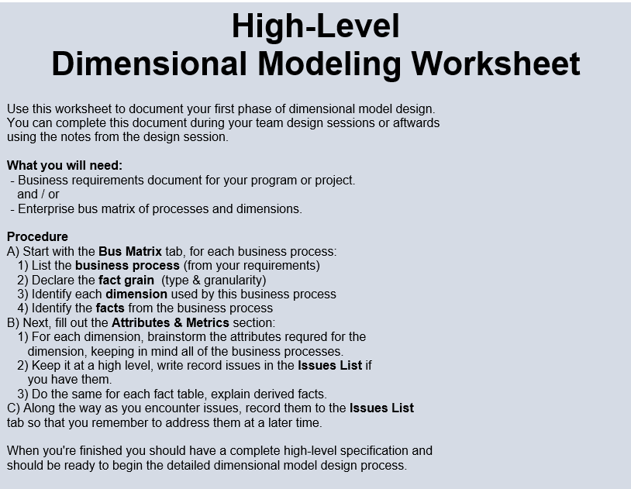
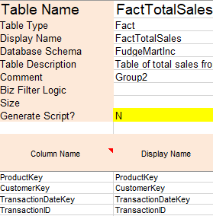
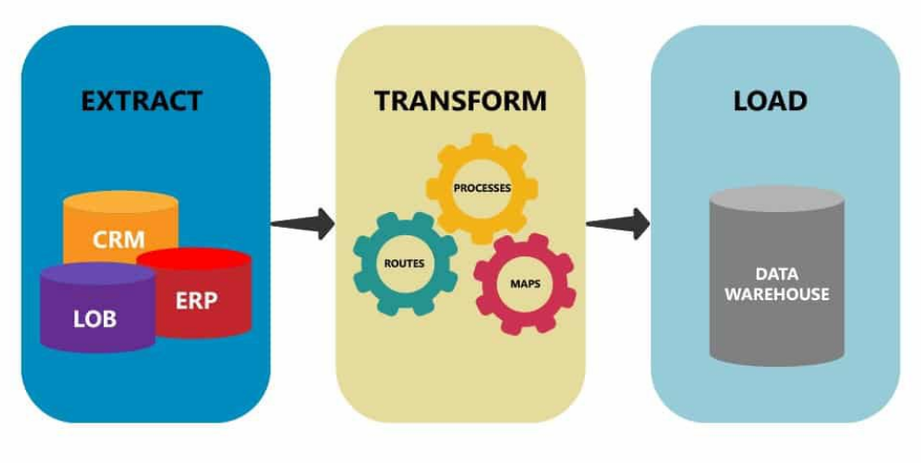

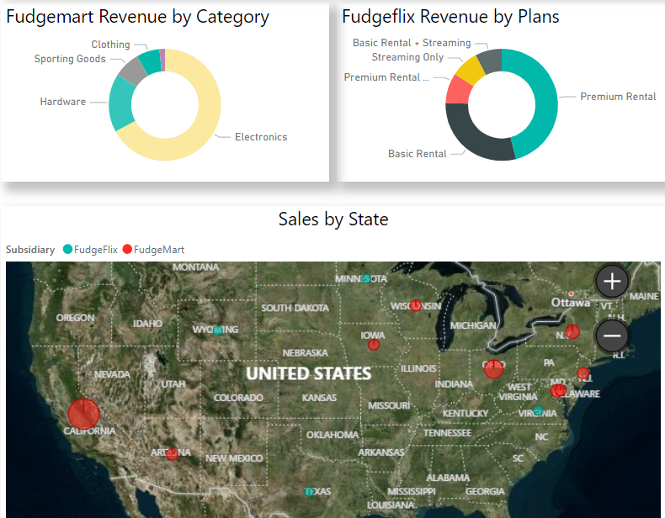

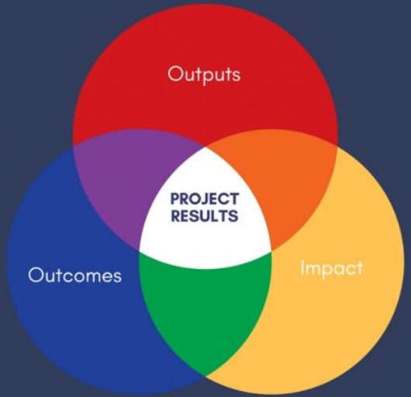
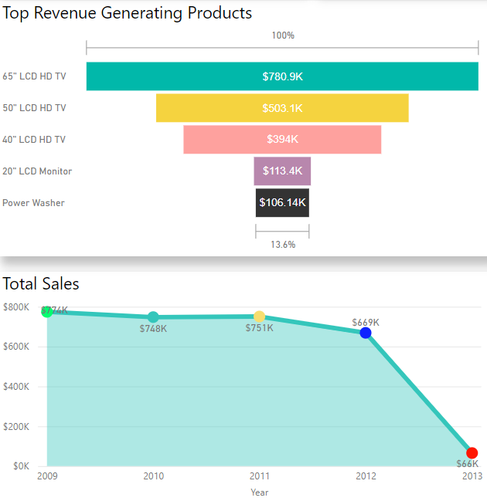
Deliverables
Project Charter
High-level Model
Detailed Dim Model
ETL Operation
Data Warehouse
BI Dashboard
Presentation
Outcome/Actions

Slide 7
Data Extraction
Schema
&
ETL

Slide 8
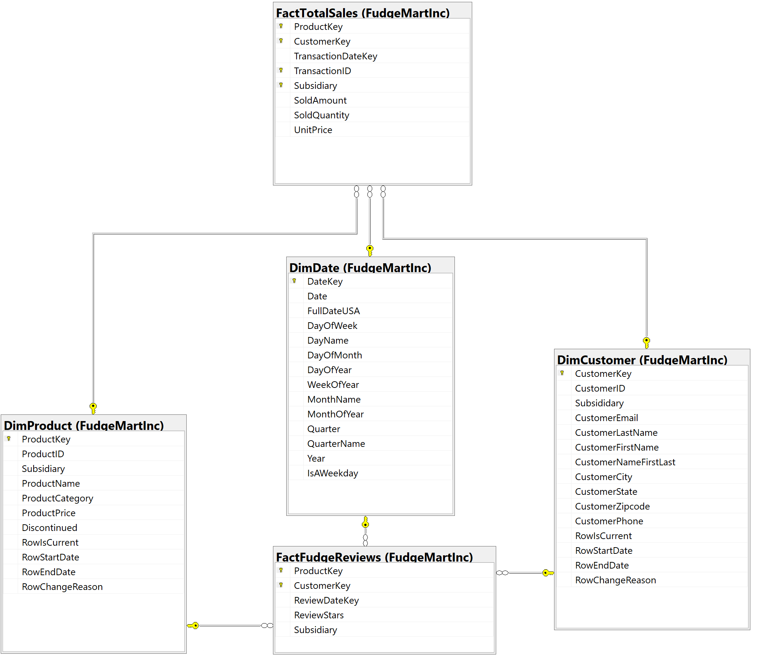
Star Schema

Slide 9
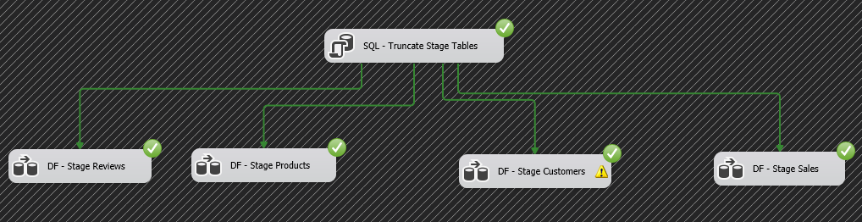
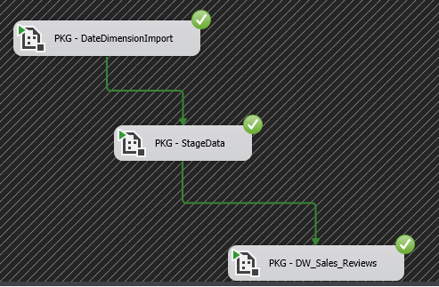
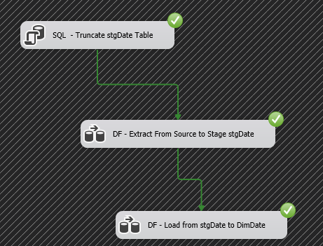
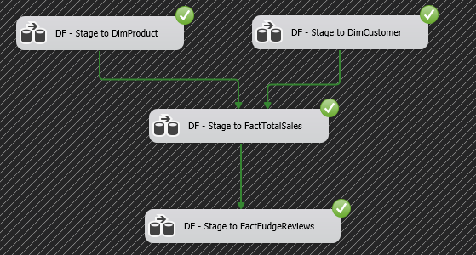
ETL
Stage
ETL packages execution
Date Import execution
DW Import execution

Slide 10
Business Intelligence
Product Reviews
Fudgemart_FudgeFlix_Product_Review_BI Live

Slide 11
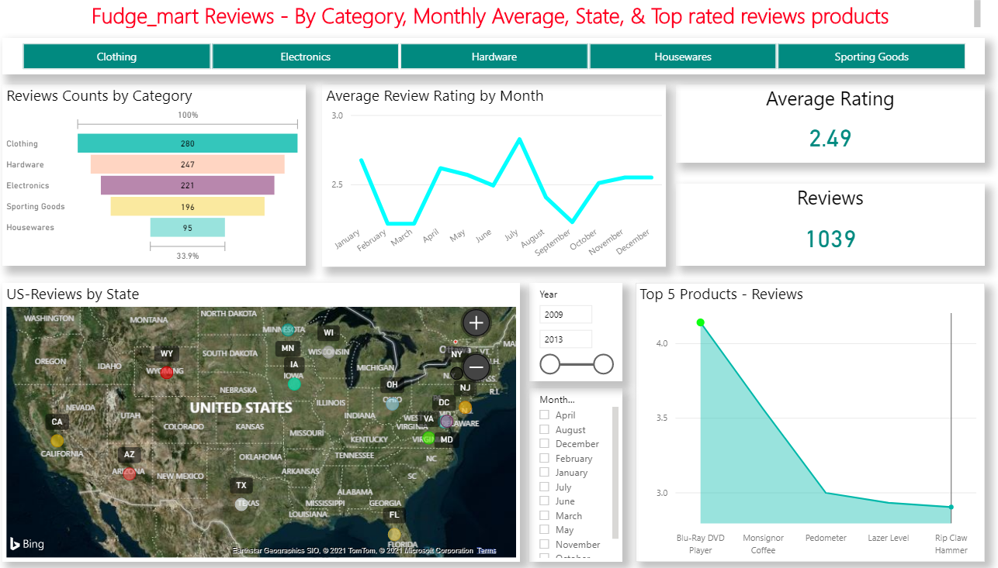
Business Intelligence – Product Reviews

Slide 12
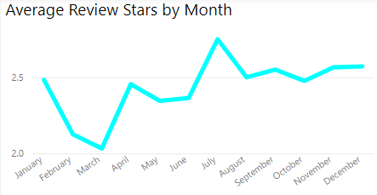
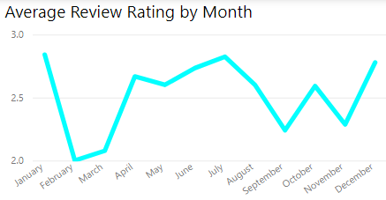
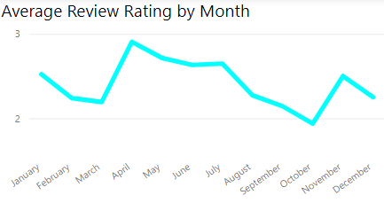
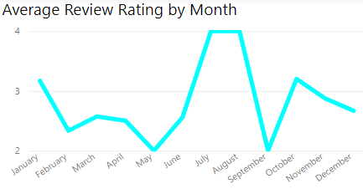
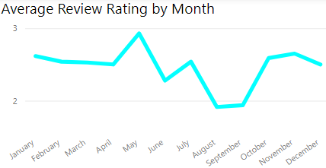
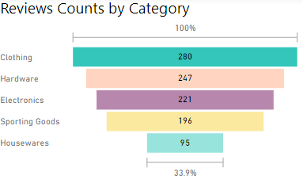
Business Intelligence –Reviews By Category
Clothing
Electronics
Hardware
Housewares
Sporting goods

Slide 13
Product Reviews Improvement
- Need to improve the product review experience by simplified and encouraging process instead of multiple questions to answer and written feedbacks.
- Reminders to review the recent purchase(s) and offer incentives (5% discount on next order etc.,)
- Improve shipping/returns/replacement policies. Enhanced customer experience influence reviews/surveys for products.

Slide 14
Business Intelligence
Sales Reports
Fudgemart_FudgeFlix_Sales_BI_Group2 - Report Live
FudgemartBI – Detailed Analysis

Slide 15
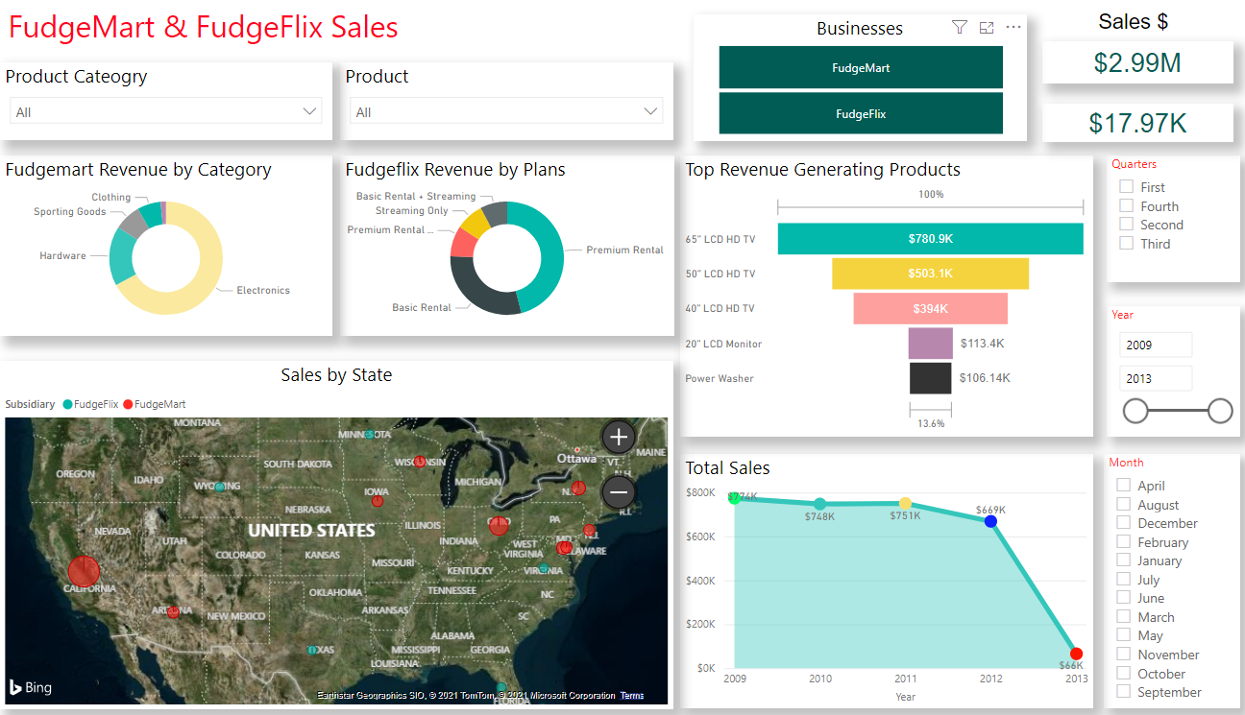
Business Intelligence – Sales Fudgemart/FudgeFlix

Slide 16
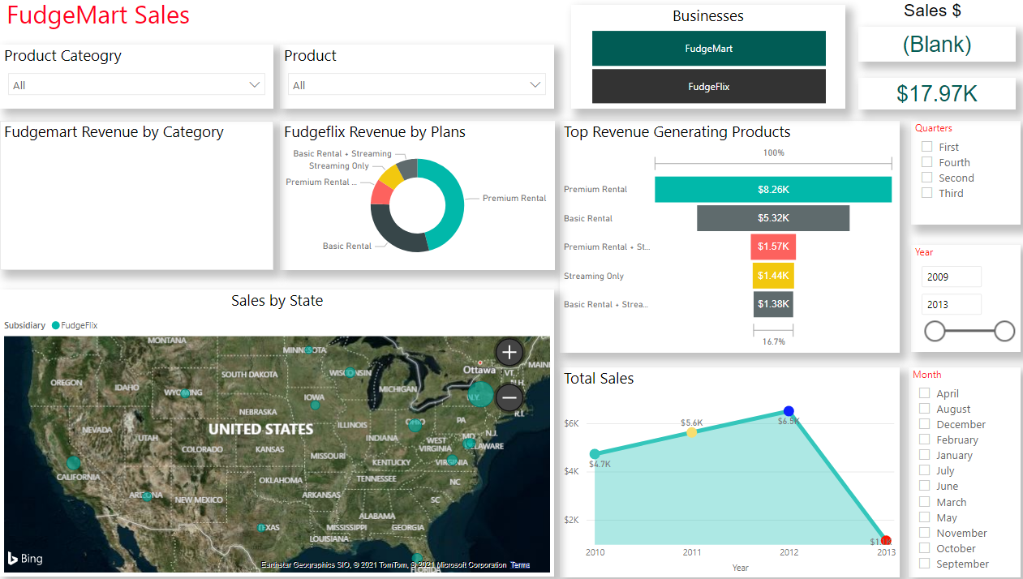
Business Intelligence – Sales for FudgeFlix

Slide 17
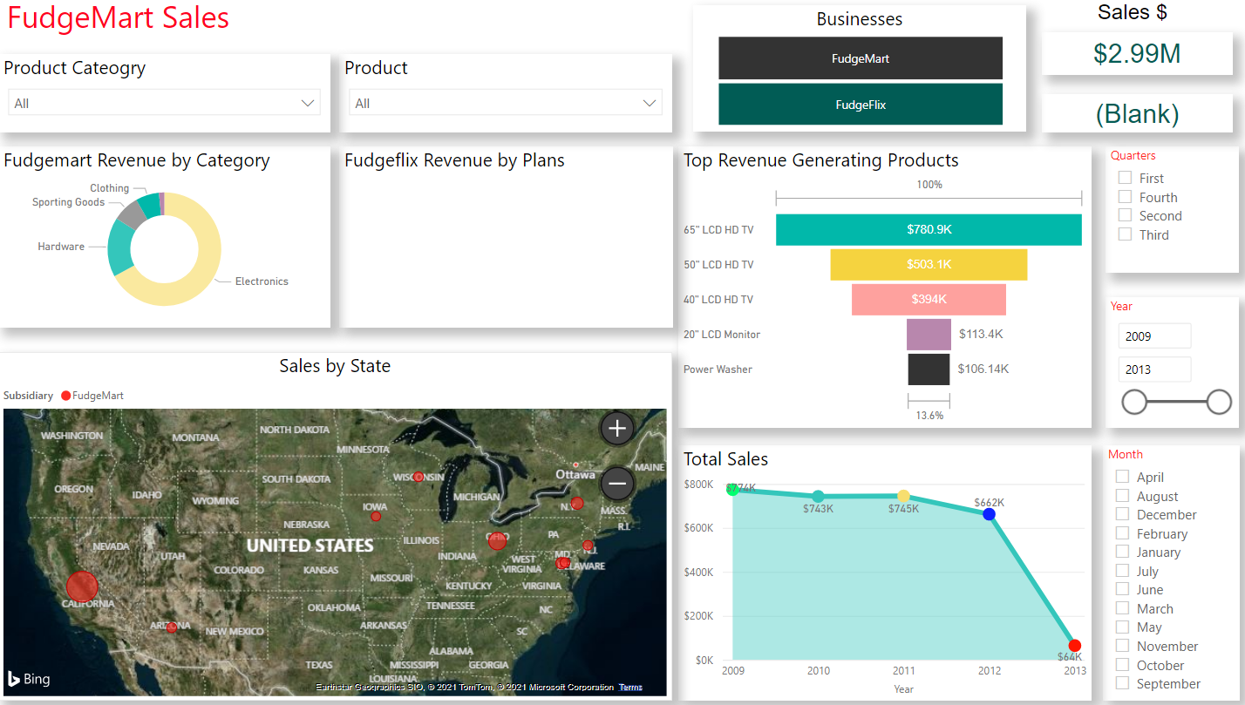
Business Intelligence – Sales for FudgeMart

Slide 18
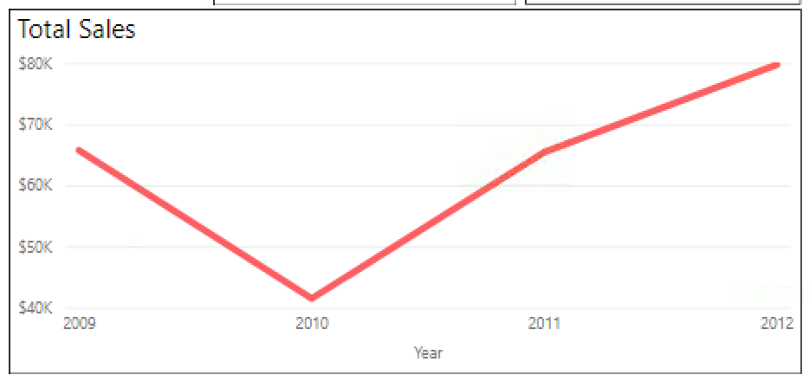
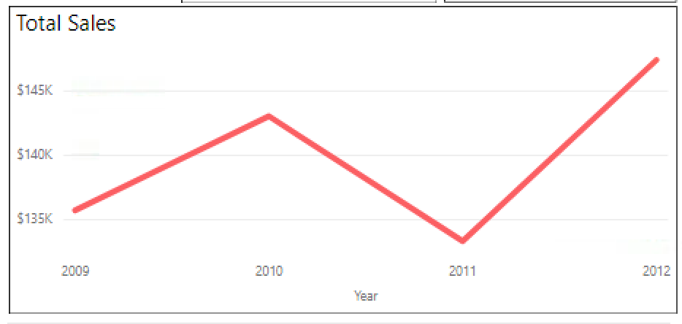
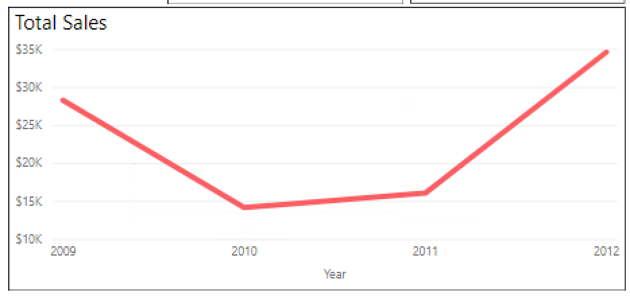
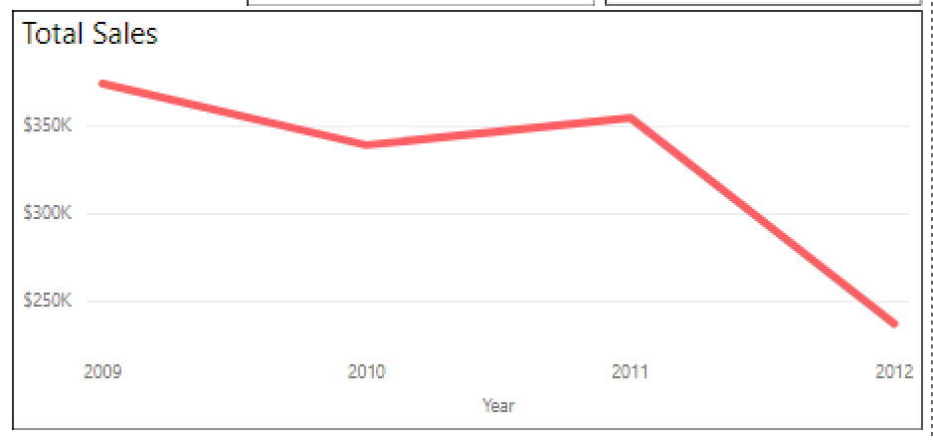
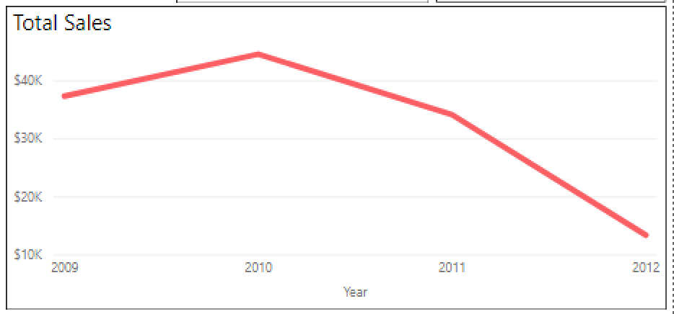
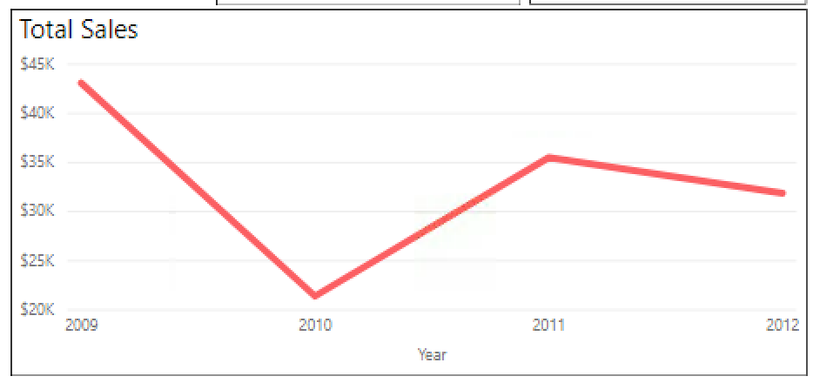
Sales Performance by State
Newyork - Up
Ohio - Up
New Jersey (Up)
California - Drop
Arizona - Drop
Wisconsin - Drop

Slide 19
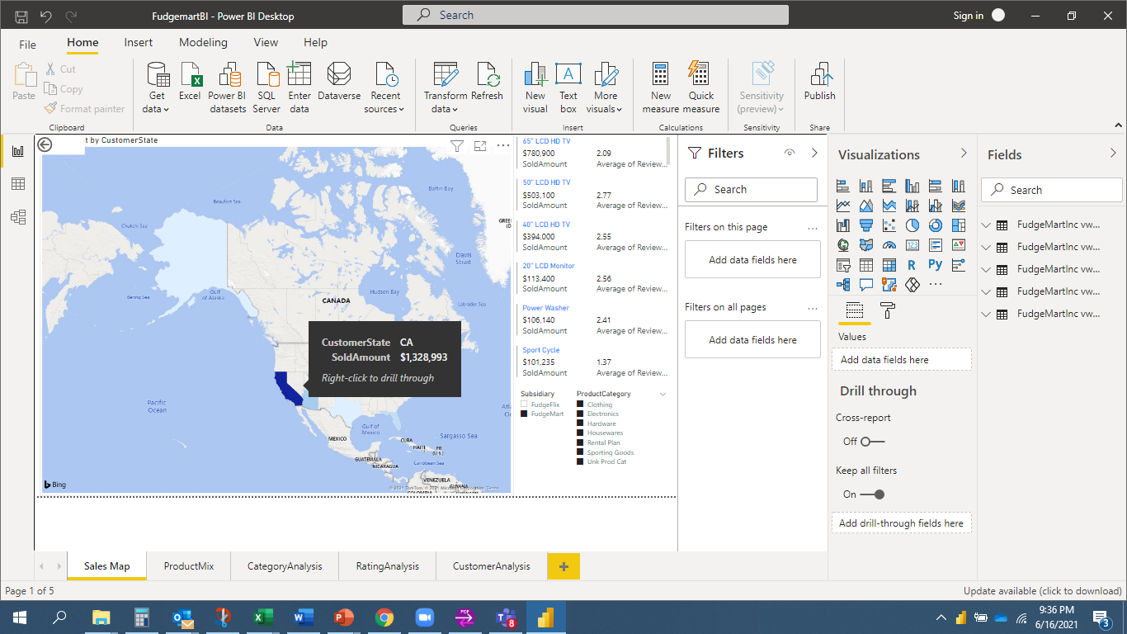
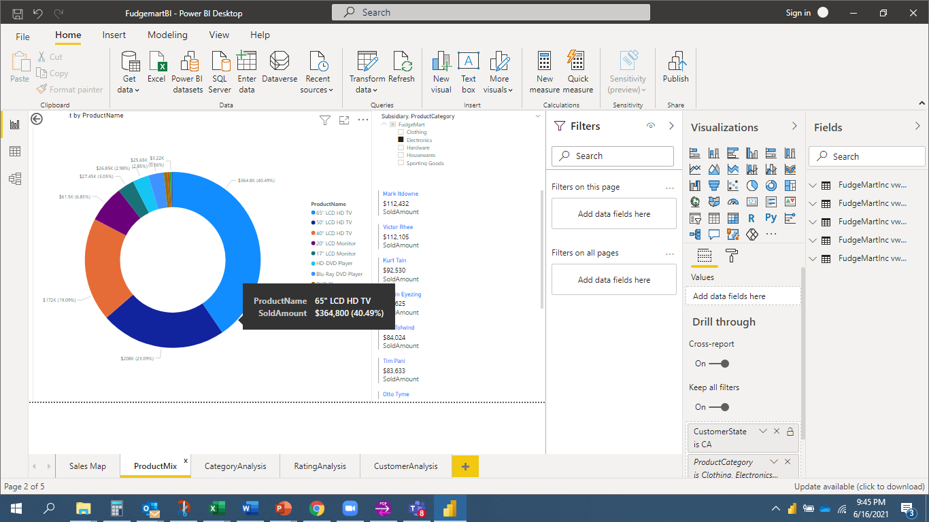
Sales – Interactive Map by Category / Combined Sales
Sales data on interactive map by subsidiary and product category
Combined sales by top customers, region & category

Slide 20
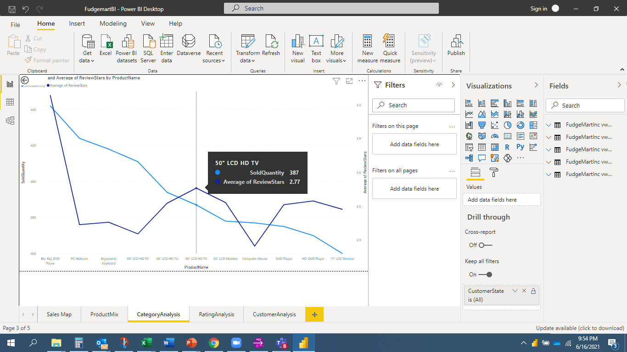
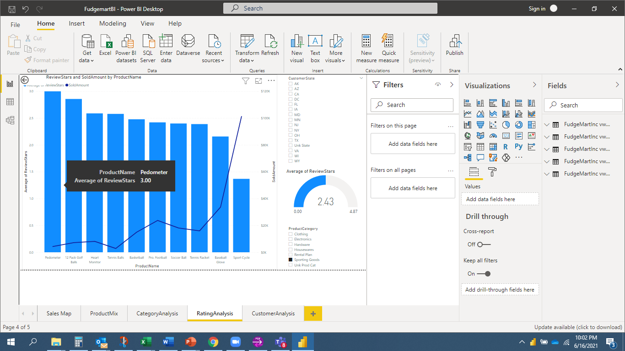
Sales – Quantity Sold vs Rating
Quantity sold Vs average product ratings for selected markets.
Review ratings and sales for selected product categories by desired market(s).

Slide 21
Outcomes / Action Items
Conclusion & Further Analysis

Slide 22
Conclusions
FUDGEFLIX
FUDGEMART
Subscribers in 16 states out of 50
Most subscriptions are one service (i.e., basic rentals)
Room for growth in upgraded, 2 service subscriptions (i.e., Premium + Streaming)
California, New York, Ohio have highest subscriptions
Premium Rental subscriptions top ranked by $ amount
Basic Rental subscriptions top ranked by subscription quantity
Subscriptions sharply declined from 2012-2013
Sales in 13 states out of 50
California has the highest total sales, but sales declined from 2011 to 2012
Across all states, top-selling products by $ amount are larger TVs (40”, 50”, 65” LCD HD TVs)
Across all states, top-selling products by quantity are running pants, baseball glove, Blue Ray DVD players
Upon examination of sales and reviews visualizations, reviews may not be as strong of a predictor of sales
Sales sharply declined from 2012-2013

Slide 23
Questions for Further Analysis
FUDGEFLIX
FUDGEMART
Why are subscriptions confined to only 16 out of 50 states?
What incentives could be offered to encourage customers to upgrade to 2 service subscriptions (i.e., Premium Rentals + Streaming)?
What incentives could encourage FudgeMart customers to also subscribe to FudgeFlix?
Why are subscription sales so low across the US?
Why the decline in subscriptions from 2012-2013?
Why are sales confined to only 13 out of 50 states?
What implications will the most popular products by $ amount and quantity have for marketing? Which perspective will be the focus?
What are the causal factors for low overall product reviews?
Is there a statistically significant relationship between reviews and sales?
Why the decline in sales from 2012-2013?
Why the decline in sales in California, Arizona, Wisconsin and the increase in sales for New York, Ohio, and New Jersey?

Slide 24
Questions?
Thank you all

